Slide 1
Deep Learning Neural Encoders for Motor Cortex
Details of paper
Liang K F, Kao J C. Deep Learning Neural Encoders for Motor Cortex[J]. IEEE Transactions on Biomedical Engineering, 2019.
01

Slide 2
Deep Learning Neural Encoders for Motor Cortex
Motivation
Build a closed-loop experimental simulator to accelerate decoder optimization
A key component of this simulator is the neural encoder
Prior neural encoders do not model important features of neural population activity
Method
Deep learning neural encoders
Conclusion
Outperform prior neural encoders in reproducing peri-stimulus time histograms (PSTHs) and neural population dynamics
Better match neural decoding results in offline data and closed-loop experimental data
02

Slide 3
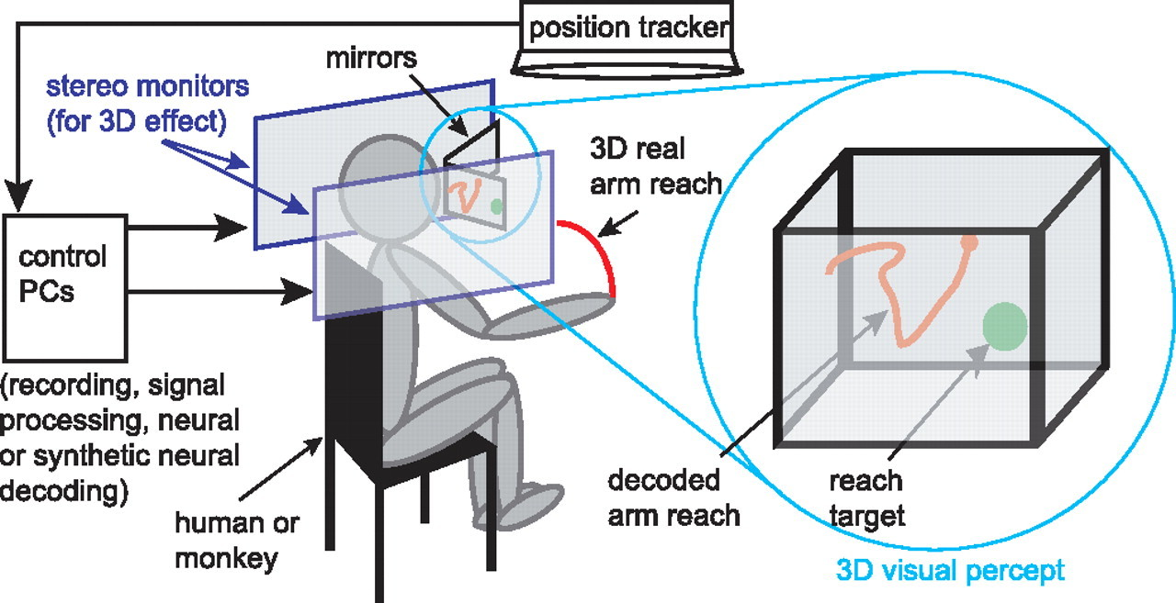
Method
Experiment
8 direction center-out-and-back reaching
open-loop experiments: the cursor position was the monkey’s hand position.
closed-loop experiments: the cursor’s movements were decoded by ReFIT-KF decoder with neural spikes summed in 10 ms bins.
02

Slide 4
Method
Comparison Metric
Pearson Correlation Coefficient (PCC) of PSTH
PSTH : the average firing rate for reaches to each of eight reach conditions‘
concatenated the PSTH for each of eight reach conditions into a vector.
calculated the PCC between these vectors for real and synthetic PSTHs
Mean Squared Error (MSE) of Neural Trajectories
calculated the principal components (PCs) of real neural population activity
projected both real and synthetic neural population into the top 7 PCs
MSE between these trajectories
Normalized Mean Squared Error of Decoded Position
MSE between positions decoded from the real and synthetic neural activity
normalized the MSE (NMSE) by dividing by the variance of decoded position from real neural data
02

Slide 5
Method
Encoding Models
Preferred Direction (PD) Model:
Poisson Process Velocity Tuning (PPVT) Model:
Generalized Linear Models (GLMs):
Linear Gaussian GLM
Linear Gaussian GLM with 4 bins of kinematic input history(GLMh)
02

Slide 6
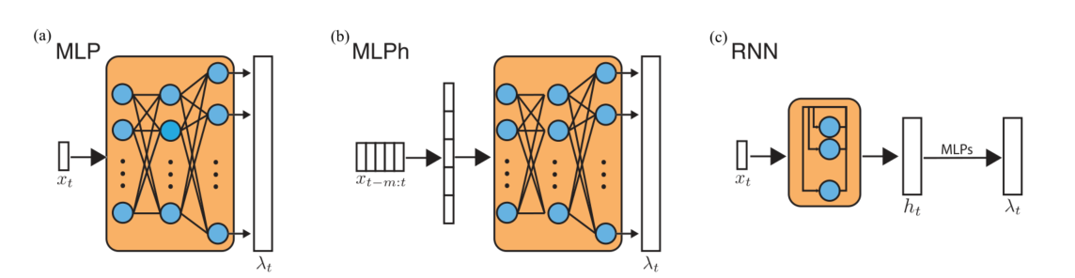
Method
Encoding Models
Multilayer Perceptron (MLP) Model
MLP With Kinematics History (MLPh) Model
RNN Model
02

Slide 7
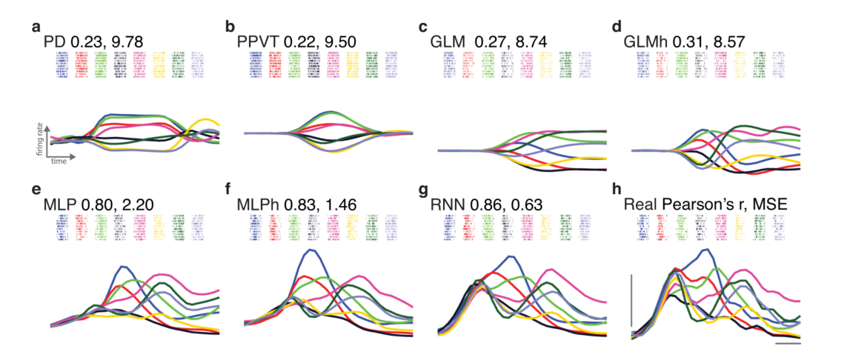
Result
DL Encoders Better Reproduce PSTHs
PCC and MSE
02

Slide 8
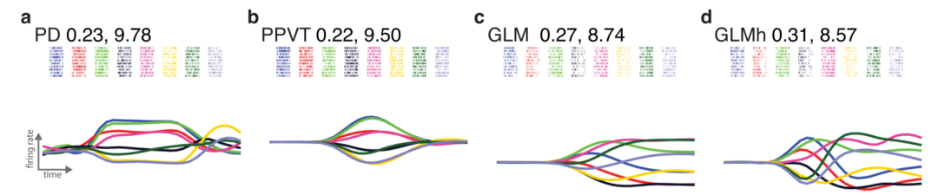
Result
DL Encoders Better Reproduce PSTHs
the PSTHs have a condition-independent increase in activity followed by heterogeneous activity that may be multiphasic
PD model achieved relatively static firing rates
PPVT incorporates speed modulation
GLM models achieved constant firing rates while approaching targets
GLMh have multiphasic PSTHs
02

Slide 9
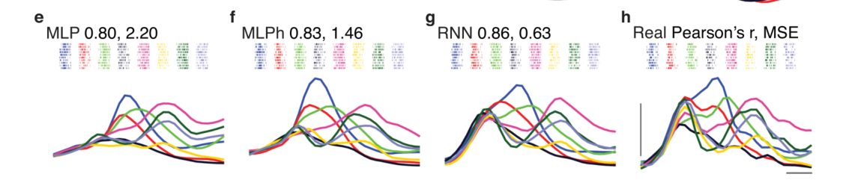
Result
DL Encoders Better Reproduce PSTHs
The MLP was capable of reproducing a condition-independent increase and qualitative motifs in the original PSTH, including the relative ordering of condition firing rates. However, it does not capture all multiphasic activity, such as the biphasic activity of the green PSTH.
RNN achieve the best result(PCC and MSE)
02

Slide 10
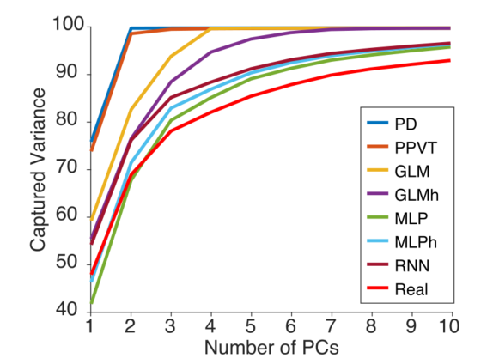
Result
DL Models Better Reproduce Neural Population Motifs
DL models more closely match the dimensionality of real data
reflecting relatively greater variability in the neural population response compared to tuning and linear models.
02

Slide 11
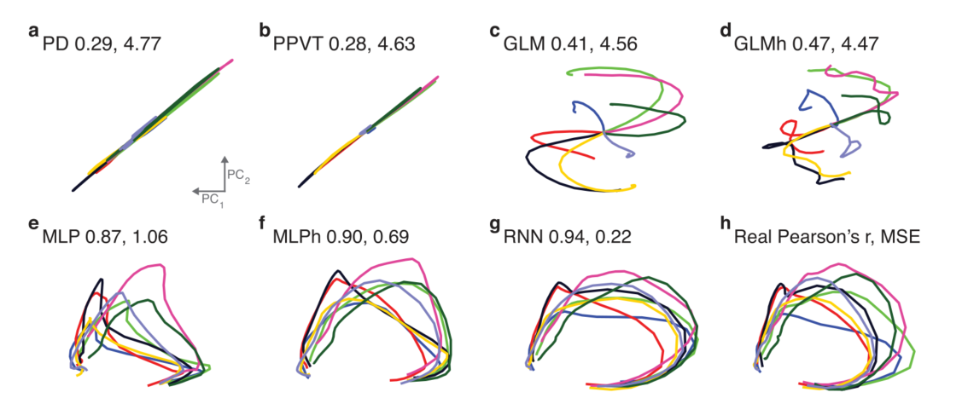
Result
Similarity of neural population trajectories
DL models better reproduced empirical neural population motifs.to tuning and linear models.
02

Slide 12
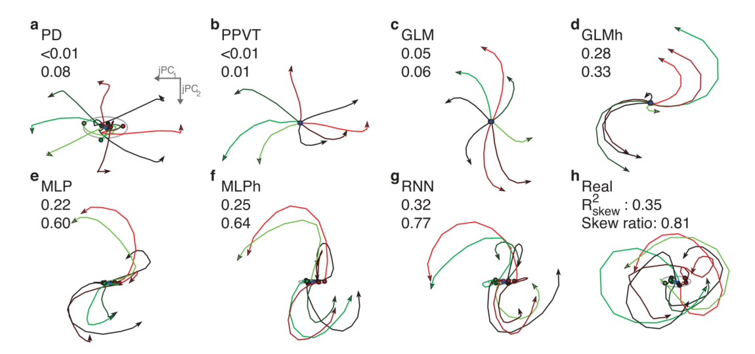
Result
compare rotational dynamics in the neural population via jPCA
DL models better reproduced empirical neural population motifs.to tuning and linear models.
02

Slide 13
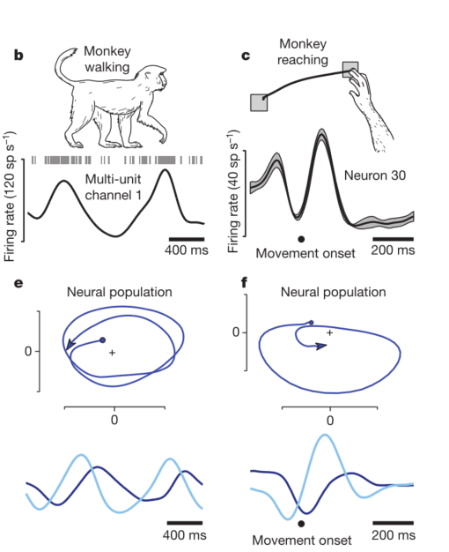
Neural population dynamics during reaching
Rhythmic responses in different systems
Population-level dynamics
jPCA
time-invariant linear dynamical system
03

Slide 14
Neural population dynamics during reaching
Skew-symmetric matrices
Mapping to vector product
PCA on skew-symmetric matrices and rotation matric
Get complex conjugate pairs eigenvectors
02

Slide 15
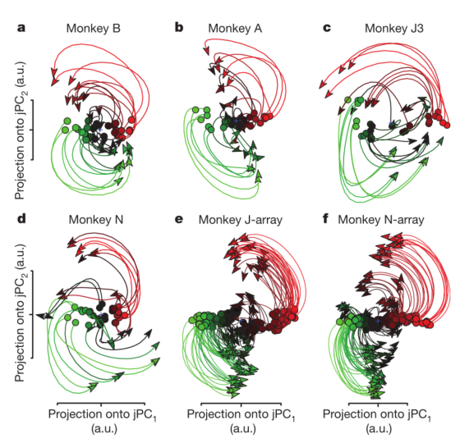
Neural population dynamics during reaching
jPCA Result
rotations of the neural state are prevalent during reaching
the neural state rotates in the same direction across conditions
state-space rotations do not relate directly to reach curvature.
01

Slide 16
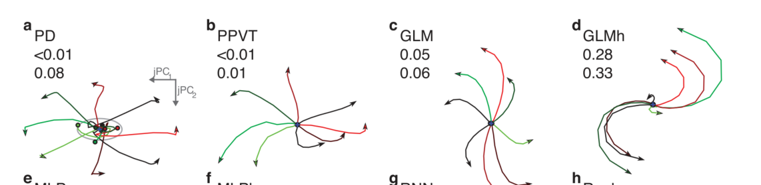
Result
compare rotational dynamics in the neural population via jPCA
PD, PPVT and GLM activity could not be well described by rotational dynamics
GLMh showed stronger rotational dynamics ,since models where neuron firing rate peaks occur at different times, with multiphasic activity, demonstrate rotational dynamics
02
Notes:
We report R2 skew, which is the variance explained in predicting the neural trajectory velocity from its position. A higher R2 skew indicates
hat the system is better described by rotational dynamics.
We also report R2 skew/R2 best, where R2 best is the variance explained using unconstrained least-squares [57]. This indicates how well rotational dynamics describe data relative to unconstrained linear dynamics.

Slide 17
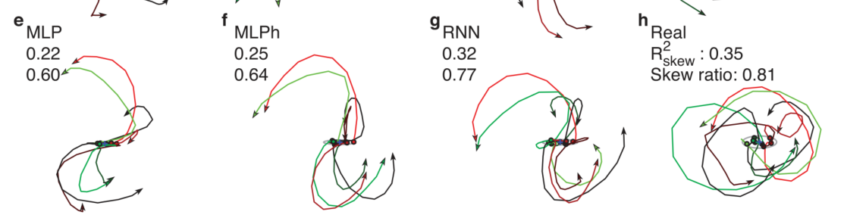
Result
compare rotational dynamics in the neural population via jPCA
though the MLP model does not have internal dynamics or utilizes any historical data, we found that its generated PSTH exhibited a degree of rotational dynamics
the degree of rotational dynamics in the encoding model output increased as the model was able to consider historical inputs(RNN and MLPh outperform MLP)
02

Slide 18
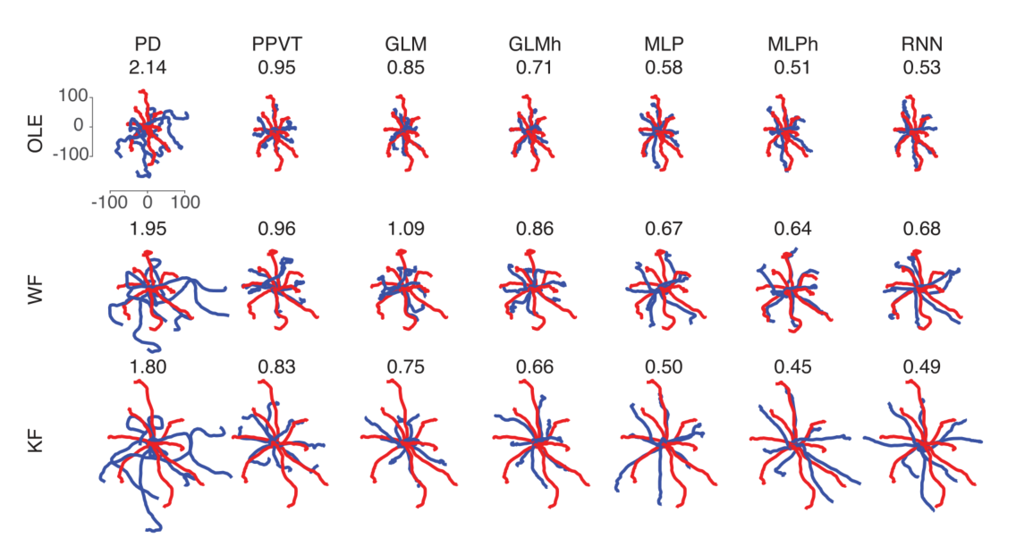
Result
Kinematics Decoded From DL Generated Neural Activity Better Match Open-Loop Decoded Kinematics
Decoded positions from DL models have relatively better NMSE compared to tuning and linear models.
NMSE
MSE between positions normalized by dividing by the variance of decoded position from real neural data
02

Slide 19
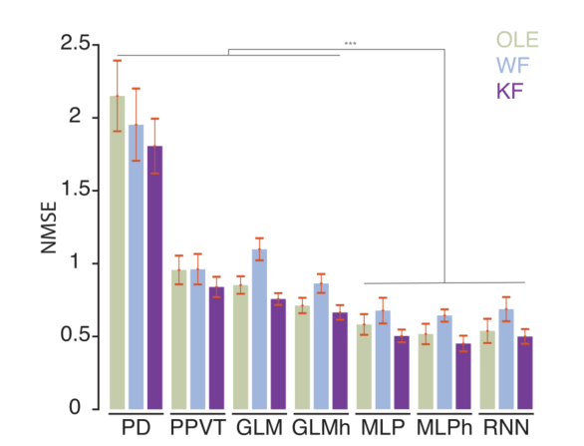
Result
Kinematics Decoded From DL Generated Neural Activity Better Match Open-Loop Decoded Kinematics
incorporating kinematic history is important for reproducing decoding(GLMh outperform GLM;MLPh and RNN outperform MLP)
Models incorporating kinematic history better reproduce dynamical aspects of motor cortical activity
RNN model was not always better than the MLPh model when decoding testing data.
02

Slide 20
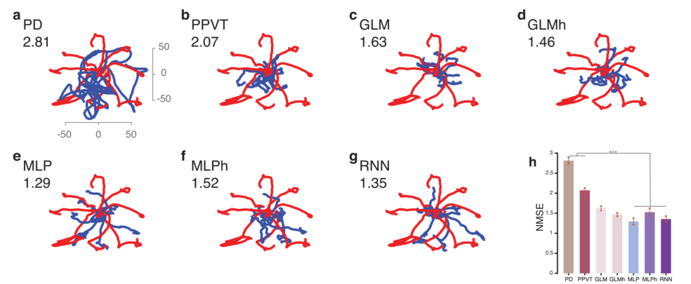
Result
Kinematics Decoded From DL and GLMh Models Better Match Closed-Loop Decoded Kinematics
the DL encoding model synthetic activity could be better decoded to produce kinematics than tuning models. GLMh model performed comparably to DL models
02
Notes:
trained encoding models on an open-loop center-out task performed with the native hand
tested on closed-loop BMI dataset.
used the kinematics of the monkey’s arm to generate synthetic neural activity, and subsequently decoded this activity post-hoc using the ReFIT-KF decoder.
Compare position NMSE between real and synthetic
一个问题：该实验close-loop意图运动用的是手的数据，但瘫痪病人这边没有反应真实意图运动的数据，用当前时刻最优的运动数据不知道是不是不太合适

